Slide 1
CS-is-2010: Project Survey Webpage Rajat Varma

Slide 2

Problem Statement
Develop a survey web page tailored for a smartwatch
Questions focused on aspects such as aesthetics, battery performance, raise-to-wake accuracy, notifications, and overall comfort.
Respondents will express their opinions using a Likert scale from 1 to 5, indicating satisfaction with the feature.

Slide 3
Architecture
Webpages
SQLite Database
User
Admin

Slide 4
Tools and Frameworks
Haskell: primary language
Yesod: Haskell framework for web development
Hamlet, Cassius and Julius: Modified versions of HTML, CSS and JS that interact with Yesod
SQLite: Persistent database for storing reviews

Slide 5
Current Prototype
Barebones form page
DB update on form submit
Barebones admin page to view responses

Slide 6
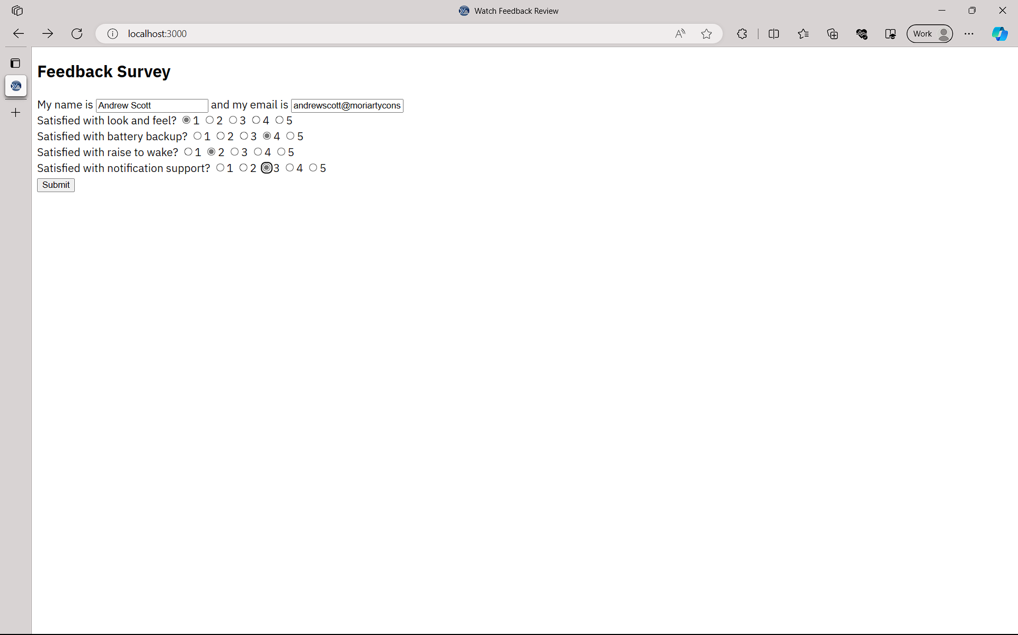
Current Prototype

Slide 7
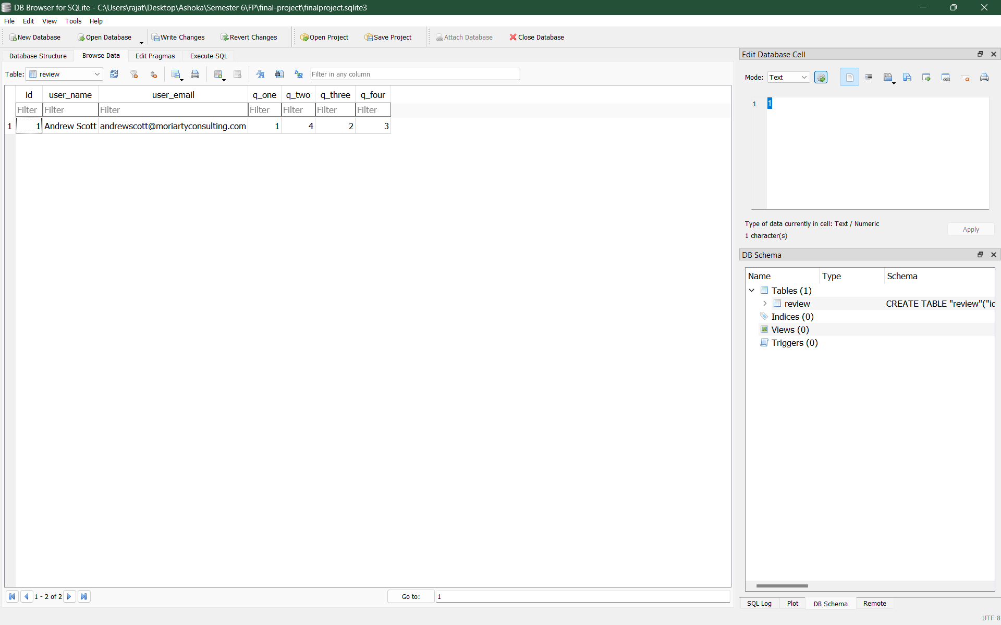
Current Prototype

Slide 8
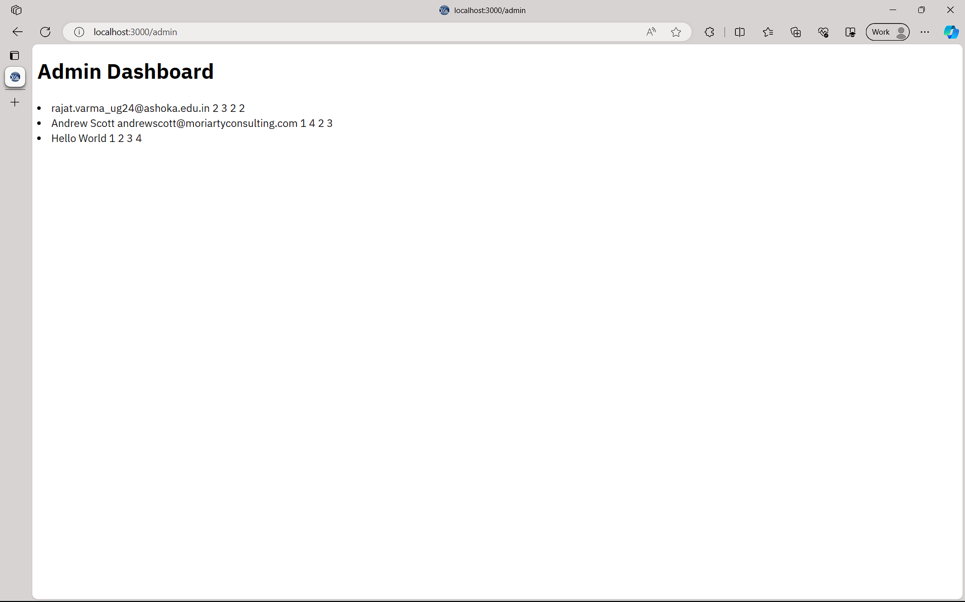
Current Prototype

Slide 9
Next Steps
Add email validation in the form
Improve the UI of the web pages
Adding more features to the admin page, such as filtering responses, seeing crunched statistics and even modifying the DB.
Add download as CSV functionality

Slide 10
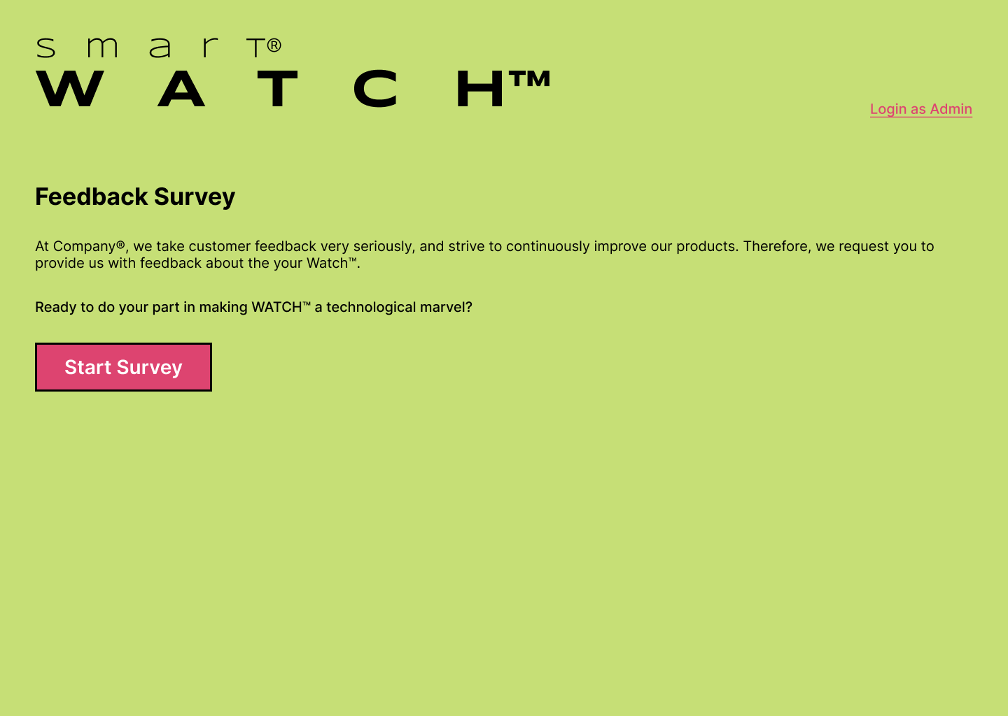
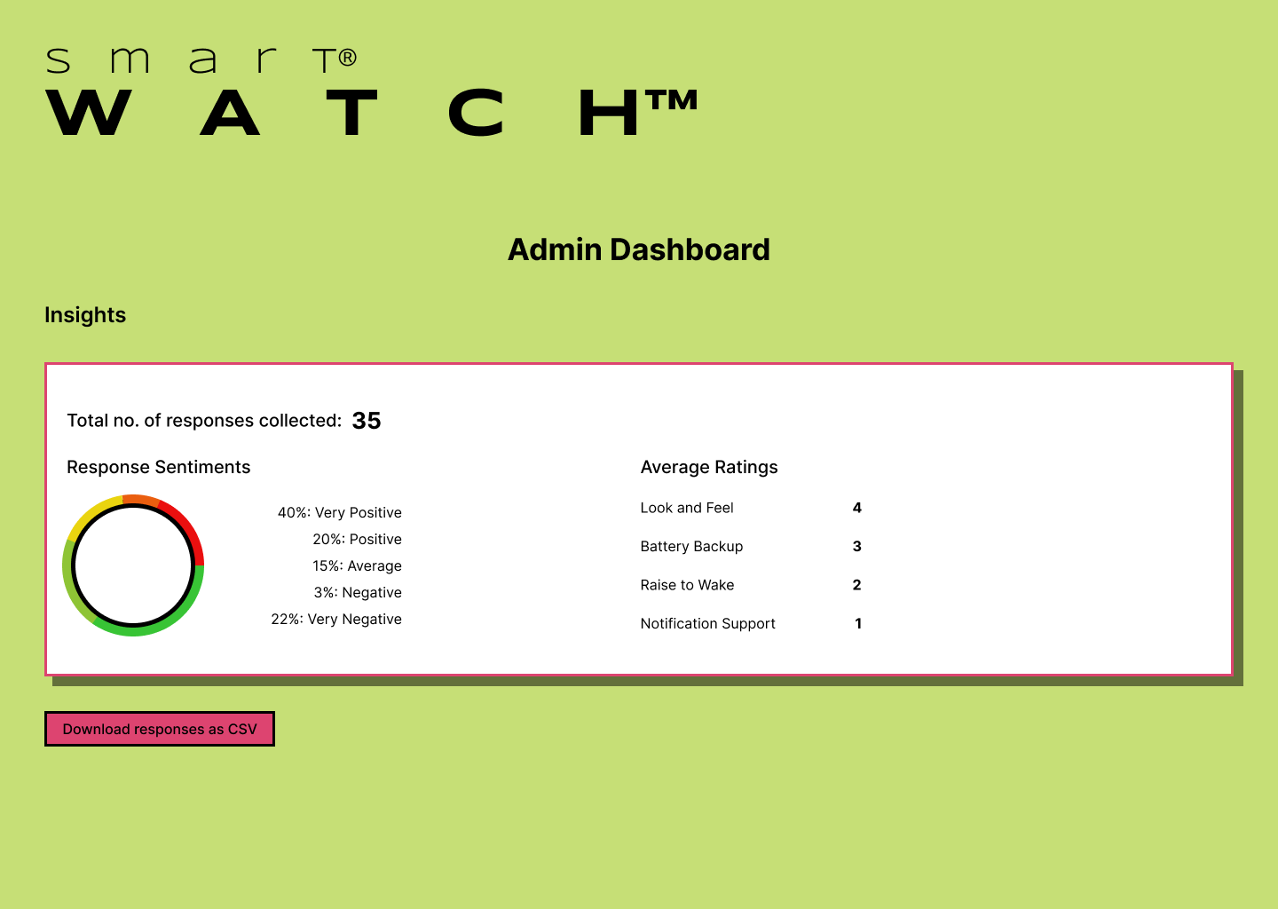



UI Mockups

